Slide 1

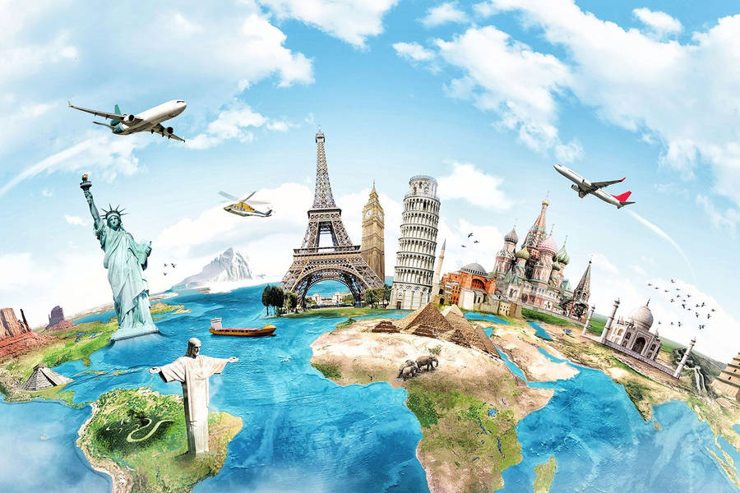

Welcome to PuP: Pick Ur Own Place!
Time to get your travel bucket list ready…
Let’s Explore

Slide 2

Welcome to PuP: Pick Ur Own Place!
Time to get your bucket list ready…travel
Let’s Explore

Slide 3
Select a country…
United States
France
Spain
England
Canada
Norway
Pick a country that you would like to explore!

Slide 4
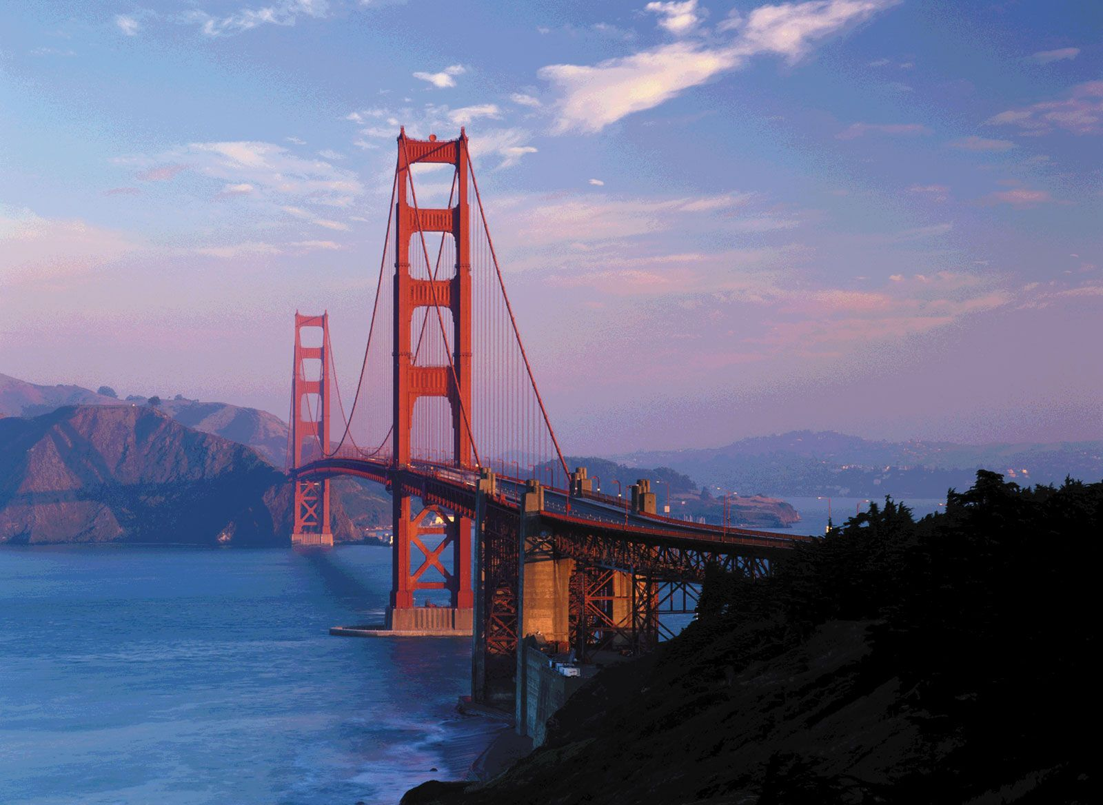
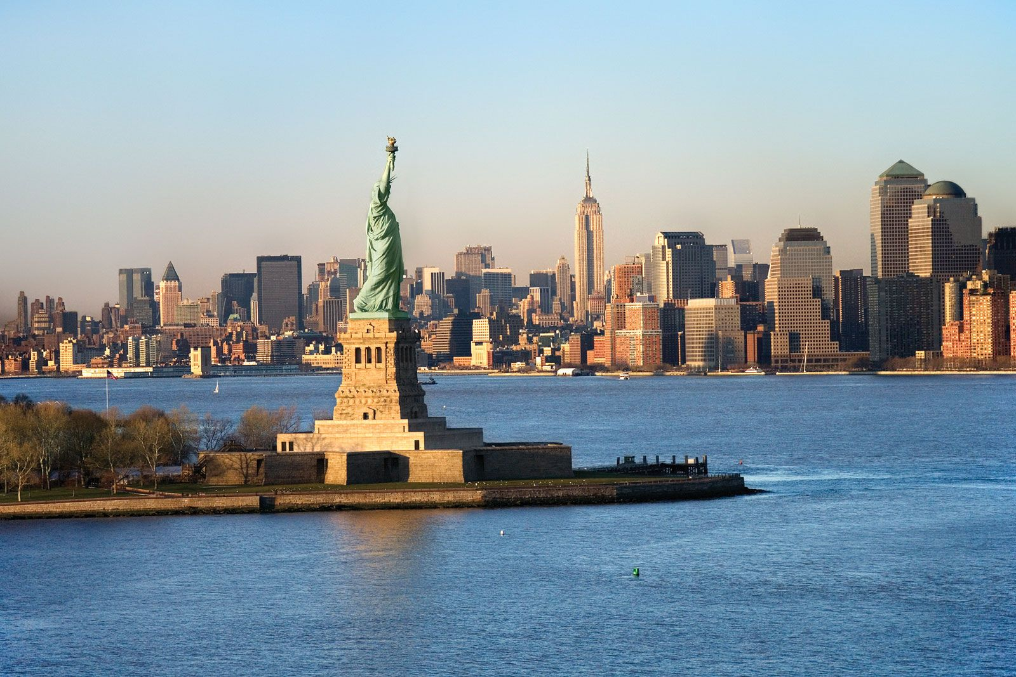

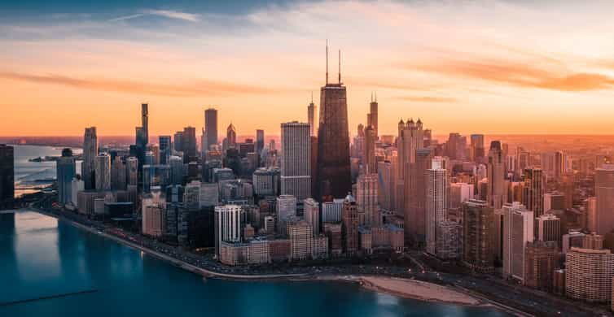
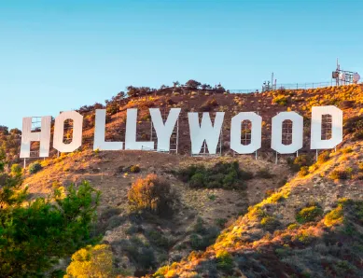
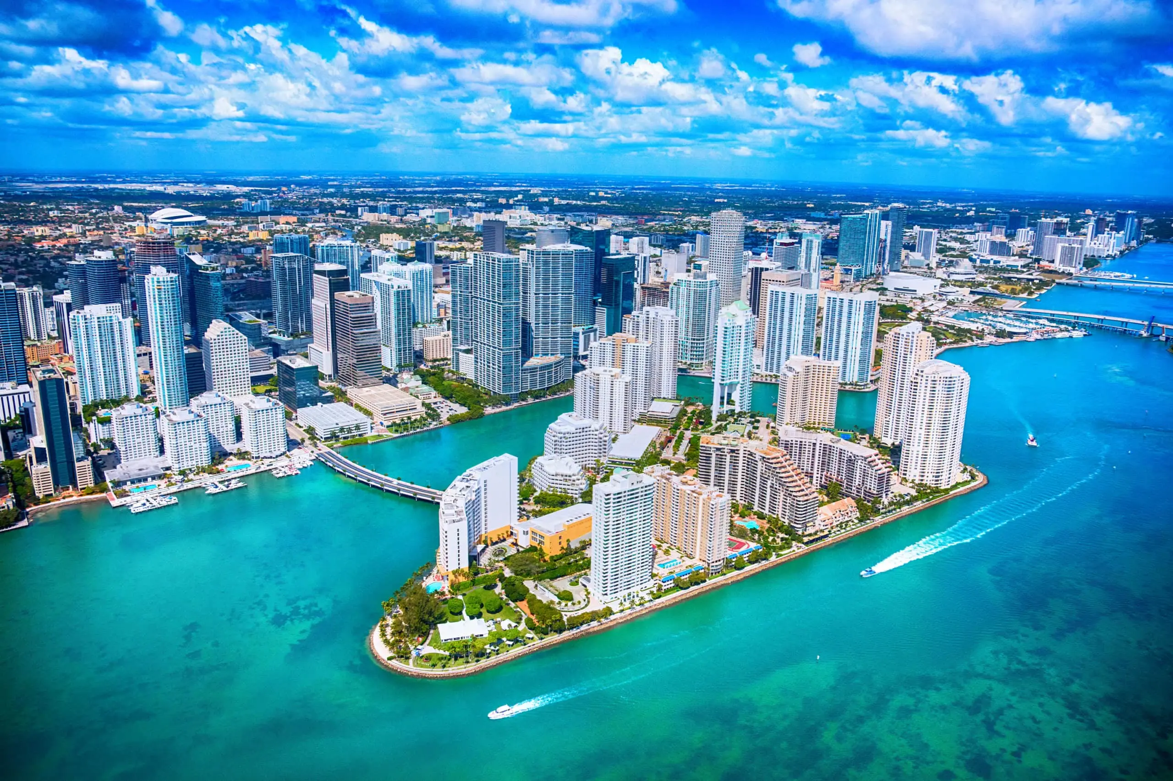
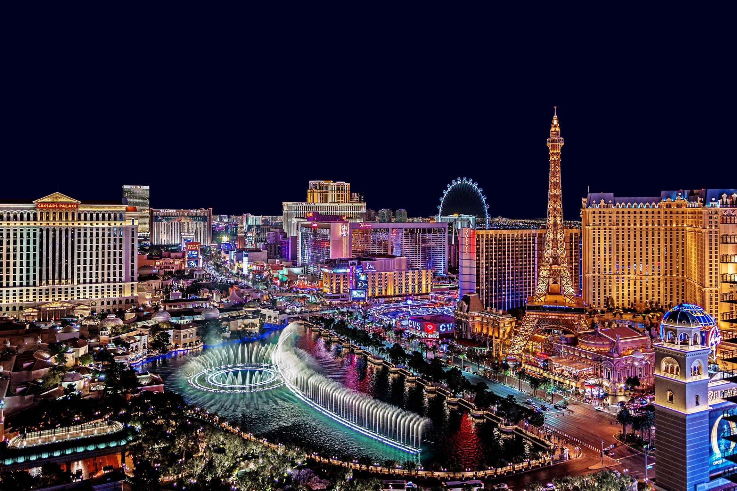
United States
San Francisco
New York
Chicago
Los Angeles
Miami
Las Vegas

Slide 5

United States
San Francisco
New York
San Francisco
City Description:
A popular tourist destination, San Francisco is known for its cool summers, fog, steep rolling hills, eclectic mix of architecture, and landmarks, including the Golden Gate Bridge, cable cars, the former Alcatraz Federal Penitentiary, Fisherman's Wharf, and its Chinatown district.
Popular Attractions:
Golden Gate Bridge Alcatraz Federal Penitentiary
Fisherman’s Wharf Chinatown
Chicago
Los Angeles
Miami
Las Vegas

